Slide 1
Customer Churn Analysis

Slide 2
Abstract
Ecommerce transactions are no longer a new thing. Many people shop with ecommerce and many companies use ecommerce to promote and to sell their products.
Because of that, overloading information appears on the customers’ side. Overloading information occurs when customers get too much information about a product then feel confused.
In this process, it can take online customer retail dataset to apply principle component analysis to get the best features from the particular feature selection.
To apply the K-Means clustering for cluster the data from dataset.
At a high level, a computer cluster is a group of two or more computers, or nodes, that run in parallel to achieve a common goal. The system is developed the different ML algorithms and estimate some performance metrics such as accuracy and visualizations.

Slide 3
Objectives
The main objective of our project is,
To apply the principle component analysis for finding best features.
To effectively create the Clusters.
The principle objective of this task is the field of cluster analysis it is essential to pick a calculation appropriate for the accessible dataset.
To implement the different ML algorithms.

Slide 4
Introduction
Ecommerce transactions are no longer a new thing. Many people shop with ecommerce and many companies use ecommerce to promote and to sell their products. Because of that, overloading information appears on the customers’ side.
Overloading information occurs when customers get too much information about a product then feel confused.
Personalization will become a solution to overloading problem. In marketing, personalization technique can be used to get potential customers in a case to boost sales.
The potential customer is obtained from customer segmentation or market segmentation. This paper will review customer segmentation using data, methods and process from a customer segmentation research. The data for customer segmentation were divided into internal data and external data.

Slide 5
Existing system
In existing system, The segmentation process done by manually in before, Since the previous models are predicted by constant data, the system needs the updated values and methods.
In old methods the whole process is done by using mathematical methods with probability and permutations.

Slide 6
Disadvantages
Limited availability and the need for time-consuming offline data reduction.
The process is implemented without removing unwanted data.

Slide 7
Proposed system
In this system, Machine learning approaches are an incredible instrument for dissecting customer information and tracking down bits of knowledge and examples.
Misleadingly wise models are useful assets for chiefs. They can exactly recognize client fragments, which is a lot harder to do physically or with ordinary logical techniques.
There are many machine learning algorithms, each reasonable for a particular sort of issue. One extremely normal AI calculation that is appropriate for client division issues is the k-means clustering algorithm.
The system is developed the different clustering techniques such as PCA and K means clustering for grouping the customers.
The system is developed the different ML algorithm such as logistic regression and decision tree. The experimental results shows that accuracy, precision, recall and f1-score.

Slide 8
Advantages
The proposed methods provide Better Feature selection for k-Means Algorithm
The process is implemented with removing unwanted data.

Slide 9

Flow Diagram
Handling missing values
Input data
Preprocessing
Label Encoding
Test
Data Splitting
Online Retail dataset
Train
PCA
Feature Extraction
K means
Clustering
DT and LR
Classification

Slide 10
Modules
Data selection
Preprocessing
Data splitting
Feature Extraction
Clustering
Classification
Performance Metrics

Slide 11
Modules description

Slide 12
Data selection
The data selection is the process of selecting the data for online retail dataset.
The dataset was collected from dataset repository.
The dataset which contains the information about the Mean, Covmat, Entropy, Label.
With the help of panda’s, we have to read our input dataset.
The dataset is in the format is ‘.csv’

Slide 13
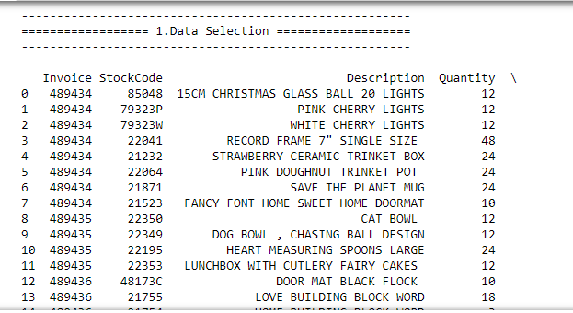
Data selection

Slide 14
Data preprocessing
Data pre-processing is the process of removing the unwanted data from the dataset.
Pre-processing data transformation operations are used to transform the dataset into a structure suitable for machine learning.
Missing data removal: In this process, the null values such as missing values and Nan values are replaced by 0.
Encoding Categorical data: That categorical data is defined as variables with a finite set of label values.
Here, we are encoded the data into labels (i.e) In our dataset, attack category attributes are converted to numeric integer value.

Slide 15
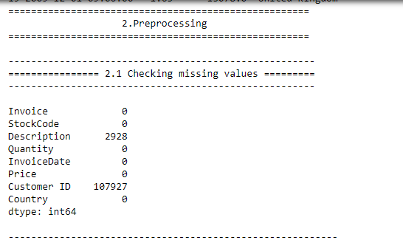
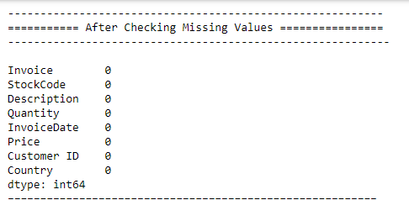
Data preprocessing

Slide 16
Data splitting
During the machine learning process, data are needed so that learning can take place.
In addition to the data required for training, test data are needed to evaluate the performance of the algorithm in order to see how well it works.
In our process, we considered 80% of the our dataset to be the training data and the remaining 20% to be the testing data.
Data splitting is the act of partitioning available data into two portions, usually for cross-validator purposes.
One Portion of the data is used to develop a predictive model and the other to evaluate the model's performance.

Slide 17
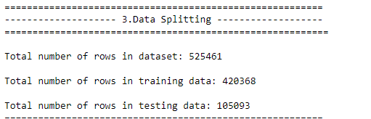
Data splitting

Slide 18
Feature Extraction
In our system, we have to implement the PCA (principle Component Analysis) for extracting the features from splitted data.
Principal component analysis, or PCA, is a statistical procedure that allows you to summarize the information content in large data tables by means of a smaller set of “summary indices” that can be more easily visualized and analysed.
It is used to reduce the number of dimensions in healthcare data. PCA can help resize an image. It can be used in finance to analyze stock data and forecast returns.
PCA helps to find patterns in the high-dimensional datasets.

Slide 19
Clustering
K-Means Clustering is an Unsupervised Learning algorithm, which groups the unlabelled dataset into different clusters.
Here K defines the number of pre-defined clusters that need to be created in the process, as if K=2, there will be two clusters, and for K=3, there will be three clusters, and so on.

Slide 20
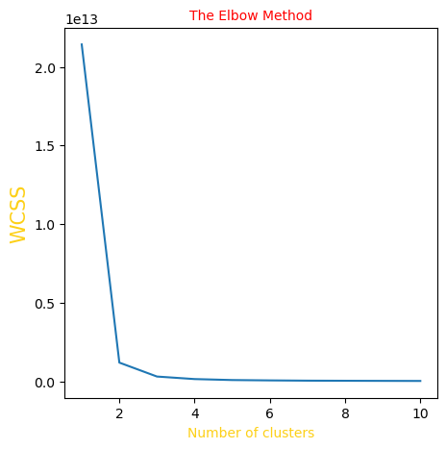
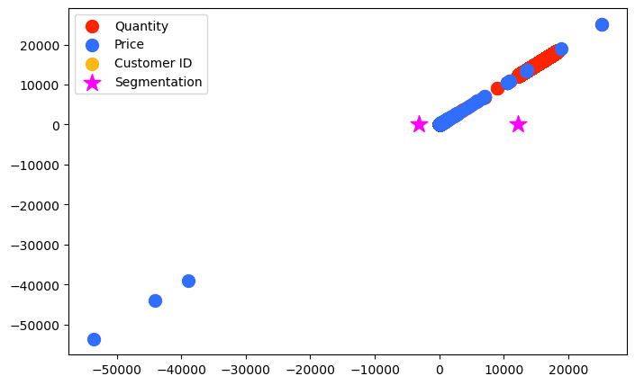
Clustering

Slide 21
Classification
In our process, we have to implement the different classification algorithm such as Logistic Regression and decision tree.
A decision tree is a non-parametric supervised learning algorithm, which is utilized for both classification and regression tasks. It has a hierarchical, tree structure, which consists of a root node, branches, internal nodes and leaf nodes.
Logistic regression is used to obtain odds ratio in the presence of more than one explanatory variable. The procedure is quite similar to multiple linear regression, with the exception that the response variable is binomial. The result is the impact of each variable on the odds ratio of the observed event of interest.

Slide 22
Performance Analysis
The Final Result will get generated based on the overall classification and prediction. The performance of this proposed approach is evaluated using some measures like,
Accuracy
Precision
Recall
F1-Score

Slide 23
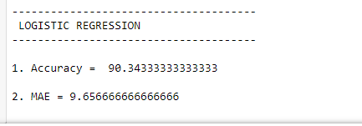
Result

Slide 24
System requirements
SOFTWARE REQUIREMENTS:
O/S : Windows 7.
Language : Python
Front End : Anaconda Navigator – Spyder
HARDWARE REQUIREMENTS:
System : Pentium IV 2.4 GHz
Hard Disk : 200 GB
Ram : 4GB

Slide 25
Literature survey

Slide 26
Title | Year | Author | Methodology | Advantages | Disadvantages
Study on various clustering techniques | 2015 | Jainendra Shukla, Miguel Barreda-Angeles, Joan Oliver, G. C. Nandi, Domenec Puig | Customer Segmentation is the subdivision of a market into discrete customer groups that share similar characteristics. Customer Segmentation can be a powerful means to identify unsatisfied customer needs. Using the above data companies can then outperform the competition by developing uniquely appealing products and services. | Feature extraction is very useful improve our accuracy in Emotional Recognition. It is easy to speed up our trained data to improve high accuracy. | One drawback of feature extraction is that the new features generated are not interpretable by humans. The data in the new variables would appear like random numbers to human eyes.

Slide 27
Title | Year | Author | Methodology | Advantages | Disadvantages
Robust clustering algorithms | 2011 | P.Gupta | Cluster analysis divides data into groups (clusters) that are either meaningful or useful or both. If meaningful clusters are the goal, then the clusters should capture the natural structure of the data. In some cases, however, cluster analysis is only a useful starting point for other purposes, such as data summarization. | We show that our algorithms can be used to cluster accurately in cases where the data satisfies a number of natural properties and where the traditional agglomerative algorithms fail. | The wave form does not researchers to distinguish between activities originating in different but closely adjacent locations.

Slide 28
Title | Year | Author | Methodology | Advantages | Disadvantages
Cluster analysis and mathematical programming | 2016 | Hansen | Consider a set of entities together with observations or measurements describing them. Cluster Analysis deals with the problem of finding subsets of interest called clusters, within such a set. Usually, clusters are required to be homogeneous and/or well separated. Homogeneity means that entities within the same cluster should resemble one another and separation that entities in different clusters should differ one from the other . T | The key benefits of these systems are their small size, lightness, low-power consumption and, of course, their wearable. | There is no affective computing research that tries to automatically recognize the user’s mood in an IVE through physiological signals and machine learning algorithms.

Slide 29
Conclusion
Customer segmentation is effectively implemented by using K-means partitioning method. Segmentation implemented like product wise, season wise, region wise, combination of season wise and gender wise. Partition method is work well large databases.
Segmentation provides loyalty between marketer and customers and provide customer relationship management, improves business and get more profit.

Slide 30
Future work
All things considered, the spotlight during this task was on the bunching investigation, the preprocessing phase of this undertaking could be improved by joining preferences and discussion to the appraisals computations utilizing some weighting of these three elements.

Slide 31
References
S. Yinbiao and K. Lee, “Internet of Things: Wireless Sensor Networks Executive summary,” 2014. F. Akyildiz, W. Su, Y. Sankarasubramaniam, and E. Cayirci
“A survey on sensor networks,” IEEE Commun. Mag., vol. 40, no. 8, pp. 102–105, 2002.
X. Chen, K. Makki, K. Yen, and N. Pissinou, “Sensor network security: a survey,” IEEE Commun. Surv. Tutorials, vol. 11, no. 2, pp. 52–73, 2009.
A.-S. K. Pathan, H.-W. Lee, and C. S. Hong, “Security in wireless sensor networks: issues and challenges,” 2006 8th Int. Conf. Adv. Commun. Technol., vol. 2, p. 6 pp.-pp.1048, 2006.

Slide 32
References
P. Yi, Y. Jiang, Y. Zhong, and S. Zhang, “Distributed Intrusion Detection for Mobile Ad Hoc Networks,” 2005 Symp. Appl. Internet Work. (SAINT 2005 Work. pp. 94–97, 2005.
H. Sedjelmaci and M. Feham, “Novel Hybrid Intrusion Detection System for Clustered Wireless Sensor Network,” Int. J. Netw. Secur. It’s Appl. (IJNSA), Vol.3, No.4, July 2011, vol. 3, no. 4, pp. 1–14, 2011.
L. Khan, M. Awad, and B. Thuraisingham, “A new intrusion detection system using support vector machines and hierarchical clustering,” VLDB J., vol. 16, no. 4, pp. 507–521, 2007.
S. K. Sahu, S. Sarangi, and S. K. Jena, “A detail analysis on intrusion detection datasets,” Souvenir 2014 IEEE Int. Adv. Comput. Conf. IACC 2014, pp. 1348–1353, 2014.

Slide 33
Thank You…

